Slide 1
Provisioning an Auto Scaling Infrastructure on Amazon Web Services using Ansible
By Alex Cohen, Deepak Kowshika and Mithun Shriyan

Slide 2
Agenda
Will cover
Introduction
Purpose, Problems and Potential Benefits
Literature Review
Methodology
Results
Demonstration
Future Work
Conclusion

Slide 3
Introduction
Amazon Web services or AWS is very popular cloud IaaS provider.
One feature of AWS is Auto Scaling Groups (ASG’s), which are groups built from EC2 instance image clones (called AMI’s) that have the ability to deploy or terminate new instances automatically to facilitate horizontal scaling in response traffic spikes.

Slide 4
Introduction
Ansible is an open source automation and configuration management software platform.
We are going to utilize specific Ansible tasks designed for AWS within a playbook that can create all the necessary architectures for an amazon web services auto scaling group automatically.

Slide 5
Purpose, Problems and Potential Benefits
How to eliminate repetition when creating AWS ASG’s and simplify the process?
Creating ASG’s is a complex and repetitive task and is therefore a perfect candidate for automation through Ansible playbooks.

Slide 6
Literature Review
Cloud Computing presents a more scalable platform
Amazon Web Services is an industry standard for IaaS
Auto Scaling Groups present a more resilient and responsive architecture that saves system administrators time and effort
Ansible provides a simple automation solution in its scripting syntax playbooks are easy to write and require very little prior programming experience.

Slide 7
Methodology
Create an amazon EC2 instance to serve as our Ansible machine and install Ansible 2.0.0 on it (as this is the version required for some of the Ansible tasks we will use in this project).
Create an amiKeys.yml file containing our AMI access key and AMI secret key, which we will encrypt using Ansible vault.

Slide 8
Methodology
3. Create a playbook utilizing the following Ansible tasks to create our infrastructure.
The ec2_elb_lb task will create and launch an elastic load balancer (ELB).
The ec2_lc task will create a launch configuration that will be used to create our auto scaling group. For this I will use the AMI image I have built of an Ubuntu Linux machines running an apache web server that connects to a MySQL database on an RDS to form a distributed LAMP architecture.
The ec2_asg task will create my auto scaling group from the launch configuration created in step b) and attach it to the load balancer created in step a).
The ec2_metric_alarm task will create two automatic cloud watch alarms for the auto scaling group with.
One alarm called CPUup that will activate if the CPU utilization of my auto scaling group is over 20%.
And a second alarm called CPUdown that will activate if the CPU utilization of my auto scaling group is under 10%.
The ec2_scaling_policy task will create two auto scaling policies using the metric alarms created in step d).
One of these policies will automatically increase my ASG instance amount by 1 if CPUup activates.
The other will automatically decrease my ASG instance amount by 1 if CPUdown activates.

Slide 9
Methodology
4. Test the architecture by visiting the DNS address of the load balancer created.
5. Test the auto scaling policies by inducing high and low CPU utilization with the tool “stress”
6. Test the load balancing capabilities by editing the HTML index files of the servers in my auto scaling groups to be slightly different and attempt to visit the DNS address of my load balancer several times in order to see if it is alternating between my servers properly.

Slide 10
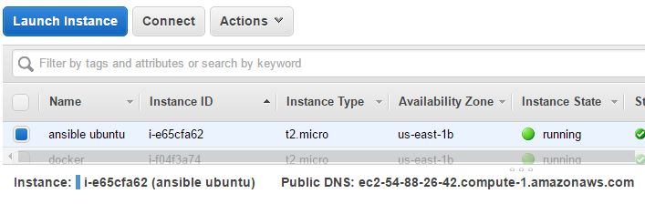
Results

Slide 11
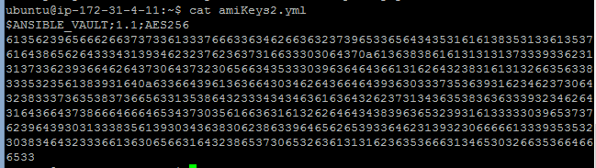
Results
---
ami_access: "JGVKLHYGLL"
ami_secret: "iliuahsdfl/HDHFKJYY&ID+"

Slide 12
Results
---
- hosts: localhost
connection: local
gather_facts: false

Slide 13
Results
vars_prompt:
#user enters the name of the ami image to make an auto scaling group from
- name: image
prompt: "enter the AMI image id"
private: no
#user enters the name that will be used to name everything else in the architecture
- name: architecture
prompt: "enter the desired name for your infrastructure"
private: no

Slide 14
Results
vars:
keypair: “somenameKeyPair"
group: "sg-asdassxxd"
subnetID: "subnet-2sfgaadsdb"
regi: "us-east-1"
loadb: "{{architecture}}-lb"
auto_sc: "{{architecture}}_asg"
lc: "{{architecture}}_lc"

Slide 15
Results
#contains the variables ami_access and ami_secret
vars_files:
- amiKeys.yml

Slide 16
Results
tasks:
#load balancer
- ec2_elb_lb:
aws_access_key: '{{ ami_access }}'
aws_secret_key: '{{ ami_secret }}'
name: "{{ loadb }}"
region: "{{ regi }}"
zones:
- us-east-1a
- us-east-1b
- us-east-1c
- us-east-1e
state: present
listeners:
- protocol: http
load_balancer_port: 80
instance_port: 80

Slide 17
Results
#launch configuration
- ec2_lc:
aws_access_key: '{{ ami_access }}'
aws_secret_key: '{{ ami_secret }}'
region: "{{regi}}"
name: '{{lc}}'
image_id: "{{image}}"
key_name: "{{ keypair }}"
security_groups: '{{ group }}'
instance_type: t2.micro
volumes:
- device_name: /dev/sda1
volume_size: 100
device_type: io1
iops: 3000
delete_on_termination: true

Slide 18
Results
#auto scaling group
- ec2_asg:
aws_access_key: '{{ ami_access }}'
aws_secret_key: '{{ ami_secret }}'
region: "{{ regi }}"
name: '{{ auto_sc }}'
load_balancers: '{{ loadb }}'
availability_zones: 'us-east-1a'
launch_config_name: '{{ lc }}'
min_size: 1
max_size: 4
desired_capacity: 2
vpc_zone_identifier: '{{ subnetID }}'
wait_for_instances: true

Slide 19
Results
#auto scaling policy
- ec2_scaling_policy:
aws_access_key: '{{ ami_access }}'
aws_secret_key: '{{ ami_secret }}'
region: '{{regi}}'
state: present
name: "{{item.pol_name}}"
adjustment_type: "ChangeInCapacity"
asg_name: "{{auto_sc}}"
scaling_adjustment: "{{item.changes}}"
min_adjustment_step: 1
cooldown: 300
register: policies
with_items:
- pol_name: "cpuUP_{{auto_sc}}_policy"
changes: +1
- pol_name: "cpuDown_{{auto_sc}}_policy"
changes: -1

Slide 20
Results
#cloud watch alarm for CPU Utilization
- ec2_metric_alarm:
aws_access_key: '{{ ami_access }}'
aws_secret_key: '{{ ami_secret }}'
state: present
region: "{{regi}}"
name: "{{item.names}}"
metric: "CPUUtilization"
namespace: "AWS/EC2"
statistic: Average
comparison: "{{item.compare}}"
threshold: "{{item.limits}}"
period: 60
evaluation_periods: 1
unit: "Percent"
description: "{{item.desc}}"
dimensions: {'AutoScalingGroupName':'{{auto_sc}}'}
alarm_actions: "{{item.pol}}"
with_items:
- names: "cpuUP_{{auto_sc}}"
compare: ">="
limits: "20.0"
desc: "This will alarm when the average cpu usage of the ASG is greater than 20% for 1 minute"
pol: "{{policies.results[0]['arn']}}"
- names: "cpuDown_{{auto_sc}}"
compare: "<="
limits: "10.0"
desc: "This will alarm when the average cpu usage of the ASG is less than 10% for 1 minute"
pol: "{{policies.results[1]['arn']}}"

Slide 21
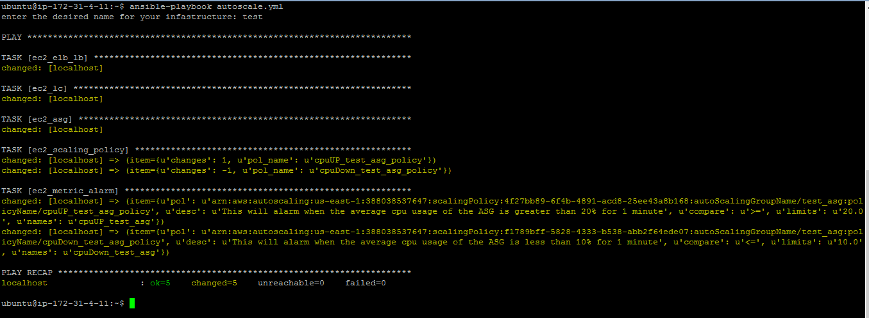
Results

Slide 22
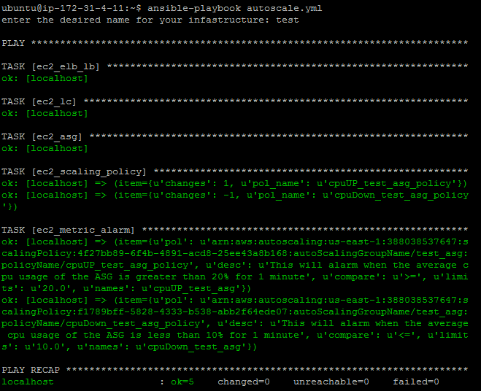
Results

Slide 23
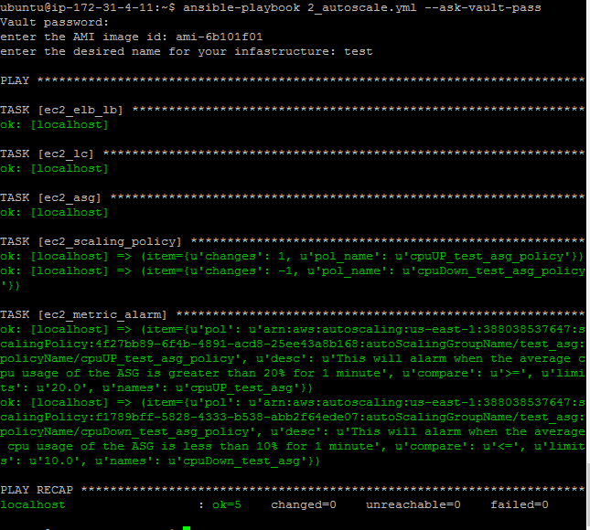
Results

Slide 24
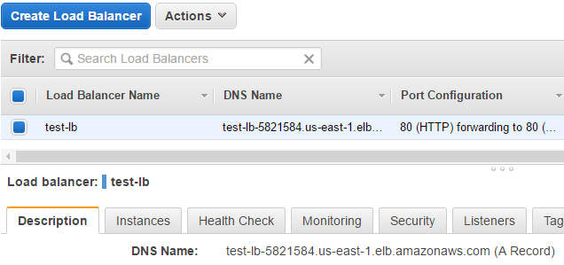
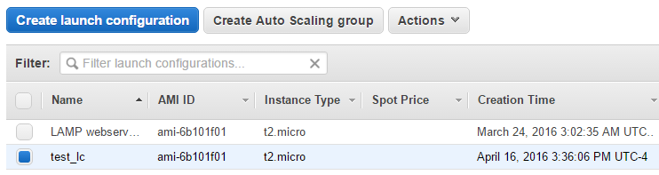
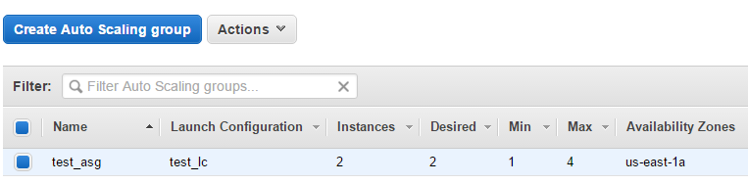
Results

Slide 25
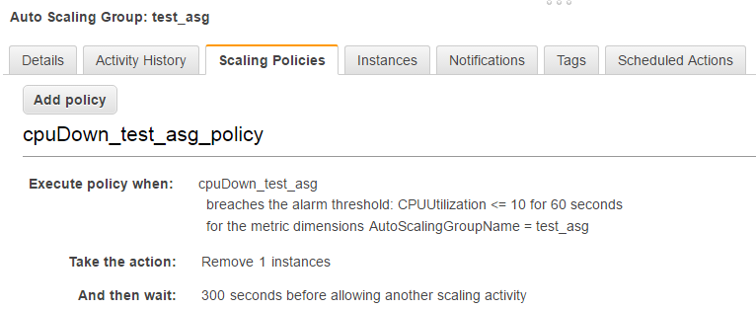
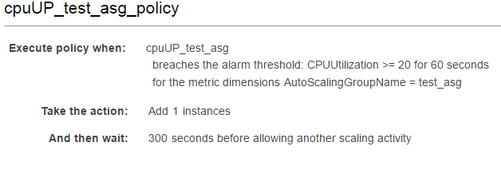
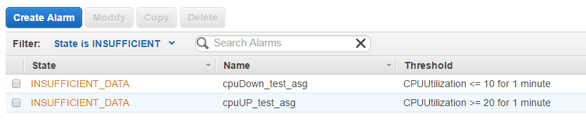
Results

Slide 26
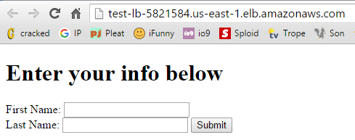
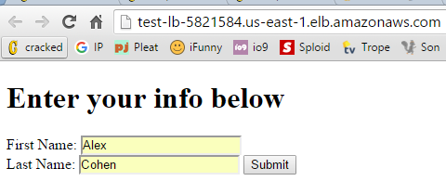


Results

Slide 27
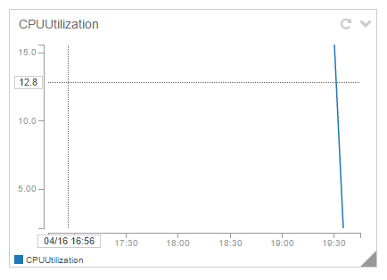
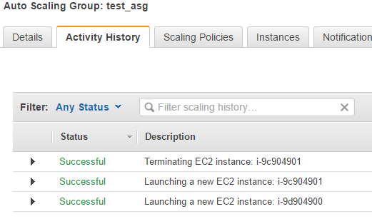
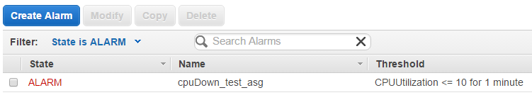
Results

Slide 28
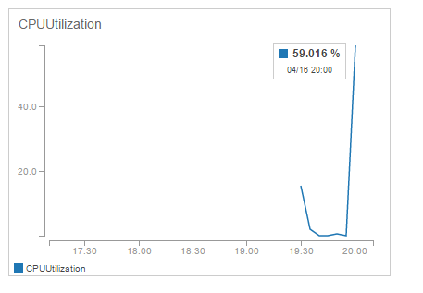
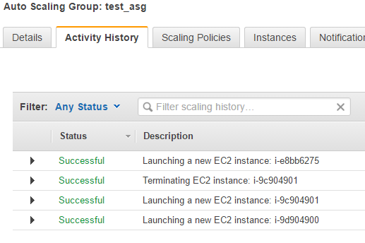
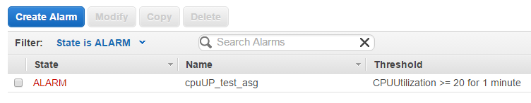
Results

Slide 29
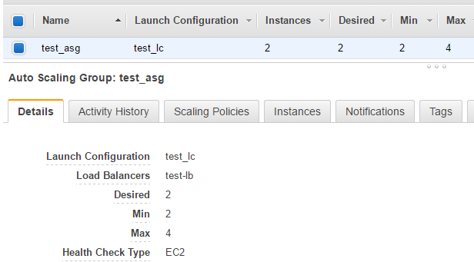
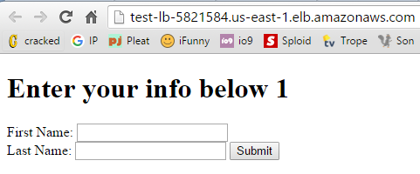
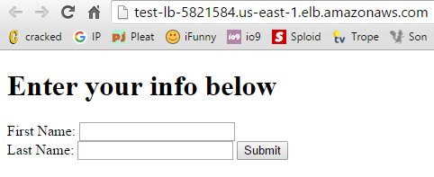
Results

Slide 30
Demonstration

Slide 31
Future Work
Ansible Tower
Using chef, salt and puppet with AWS
AWS EC2 container service
Working more with RDS
DynamoDB and NoSQL databases
Storage and content delivery architectures of AWS, such as S3
The developer tools section of AWS: CodeCommit, CodeDeploy and CodePipeline

Slide 32
Conclusion
In conclusion using an Ansible playbook to automate the process of creating an auto scaling group infrastructure was very successful and eliminated much of the repetition involved in infrastructure creation. With our playbook we were automatically able to create an ELB, launch configuration, ASG, auto scaling policies and cloud watch alarms. All of this only requires two inputs, the user’s desired name for the infrastructure and the AMI image that everything will be built off of.

Slide 33
References
Afgan, E., Krampis, K., Goonasekera, N., Skala, K., & Taylor, J. (2015, May). Building and provisioning
bioinformatics environments on public and private Clouds. In Information and Communication Technology, Electronics and Microelectronics (MIPRO), 2015 38th International Convention on (pp. 223-228). IEEE
Berlack, R. (2002). Software Configuration Management. October 24, 2015,
http://dx.doi.org/10.1002/0471028959.sof060
Configuration Management Tools. (2013). Retrieved October 23, 2015, from
http://www.mitre.org/publications/systems-engineering-guide/acquisition-systems-engineering/configuration-management/configuration-management-tools
Draps [DrapsTV]. (2015, Jun 25). Python3 Advanced Tutorial 7 - CGI Programming [Video file].
Retrieved from https://www.youtube.com/watch?v=x_1rgQwk5fM
Estublier, J. (n.d.). Software configuration management: A roadmap. Retrieved October 24, 2015, from
http://dl.acm.org/citation.cfm?id=336576
Grinter, R. (1995). Using a configuration management tool to coordinate software development.
Retrieved October 24, 2015, from http://dl.acm.org/citation.cfm?id=224036
Hardion, V., Spruce, D. P., Lindberg, M., Otero, A. M., Lidon-Simon, J., Jamroz, J. J., & Persson, A. (2013).
Configuration Management of the control system. THPPC013.

Slide 34
References
Hochstein, L. (2014). Chapter 3: Inventory: Describing Your Servers. In Ansible up & running :
Automating configuration management and deployment the easy way (Preview ed., p. 58). Beijing: O'Reilly. http://file.allitebooks.com/20150513/Ansible%20Up%20and%20Running.pdf
Intro to Playbooks. (2015). Retrieved November 7, 2015, from
http://docs.ansible.com/ansible/playbooks_intro.html
Lockhart, J. (2015). Modern PHP: New Features and Good Practices. " O'Reilly Media, Inc.".
Moser, O. [Oliver Moser]. (2015, Oct 1). What is Ansible? A short DevOps Introduction [Video file].
Retrieved from https://www.youtube.com/watch?v=xMHVvHZ-Zn4
Playbooks. (2015). Retrieved November 7, 2015, from
http://docs.ansible.com/ansible/playbooks.html
Stillwell, Mark, and Jose GF Coutinho. "A DevOps approach to integration of software components in an
EU research project." Proceedings of the 1st International Workshop on Quality-Aware DevOps. ACM, 2015.

